Slide 1
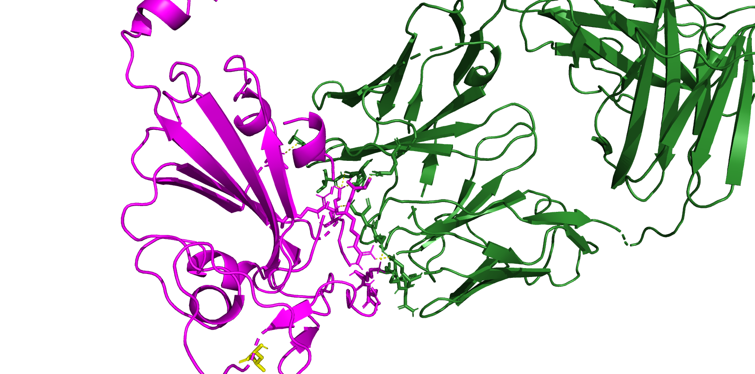
8dw9 BA286 (JN1 is after this)
A372
K440
T345
R508
K444
R346
L455

Slide 2
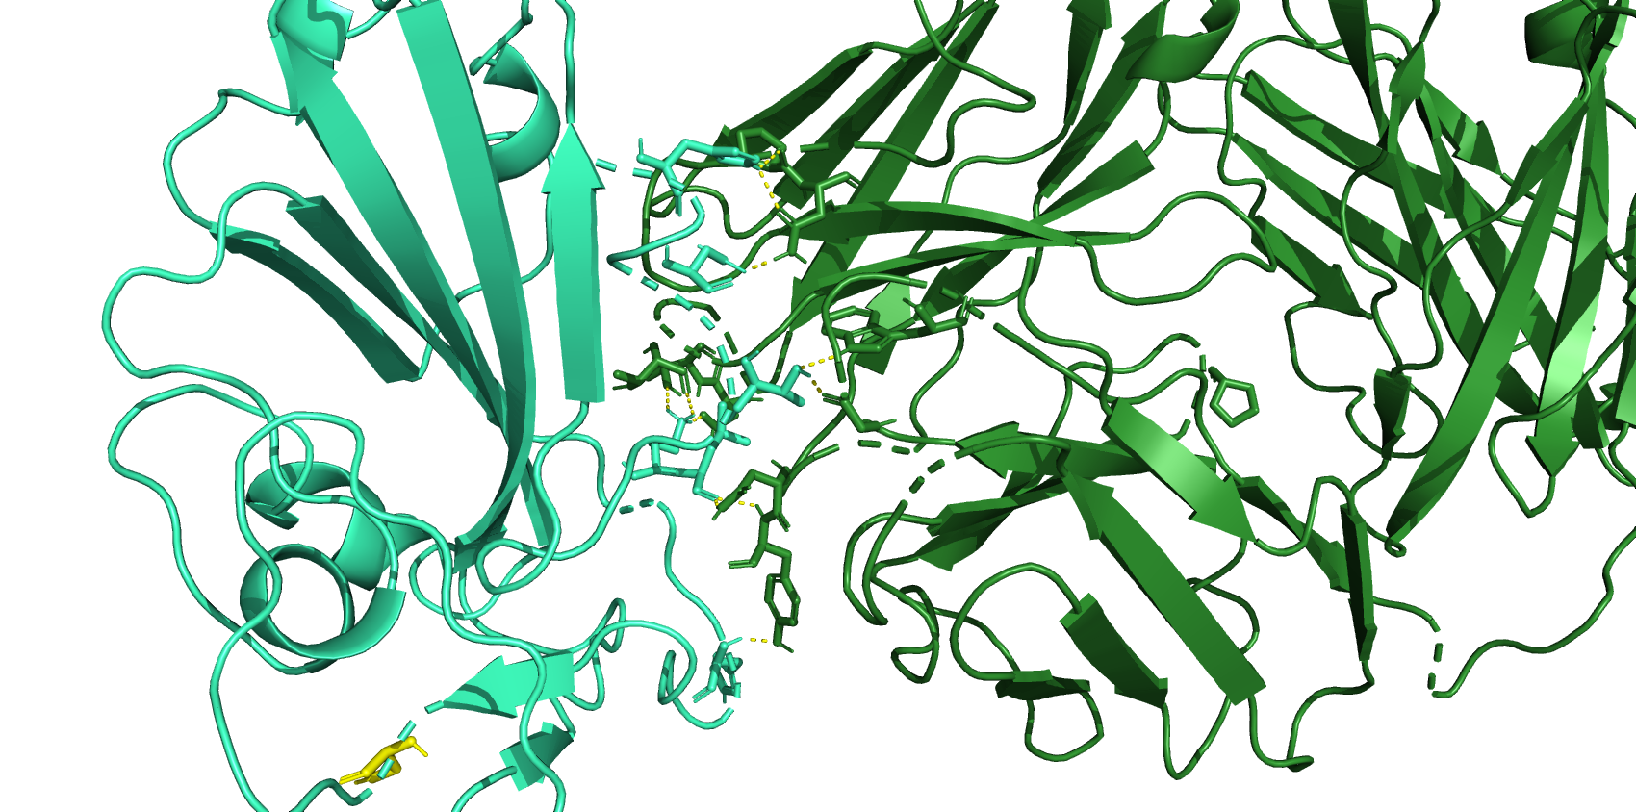
H339
N343
T345
K440
L441
H445
S455

Slide 3
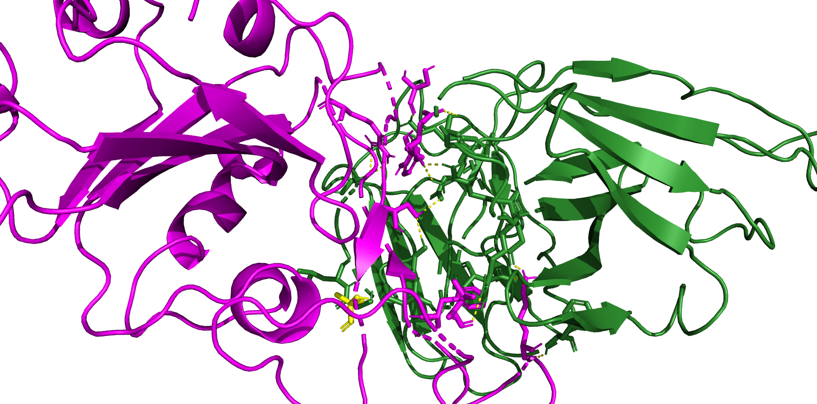
7xd2 BA.2.86 (jn.1 is after this)
R497
S446
D450
Y449
S493
I100
F489
K483
L455
T470

Slide 4
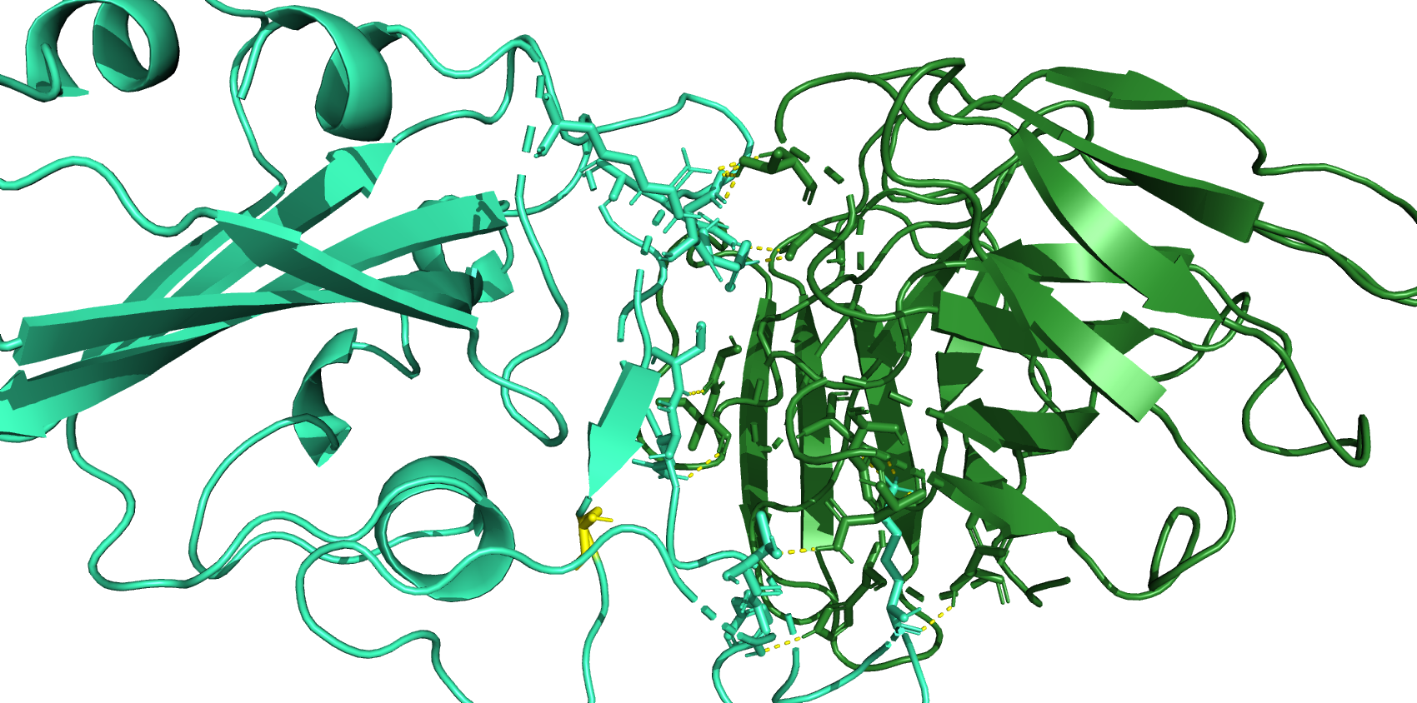
D450
R346
R497
Y449
S493
Q492
S455
K483
T470
Y488

Slide 5
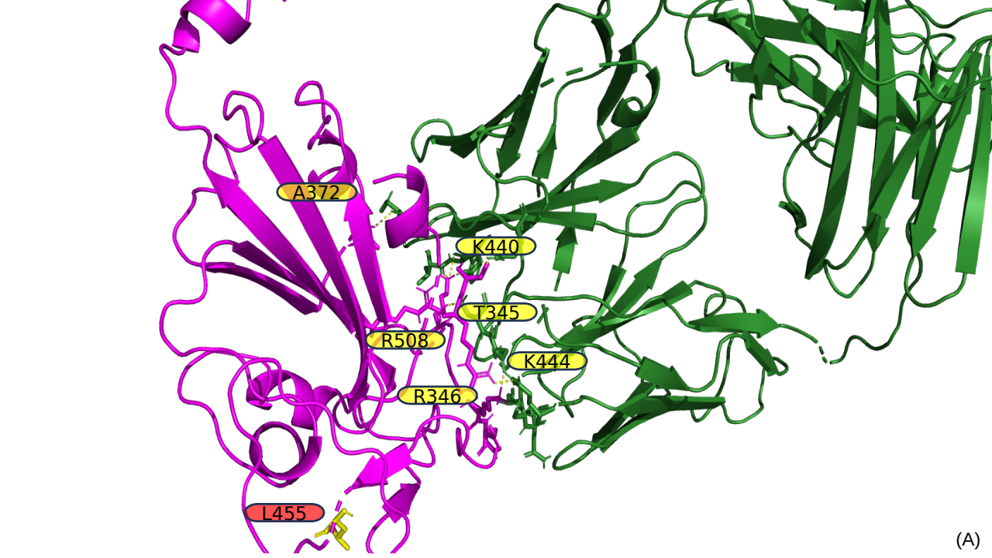
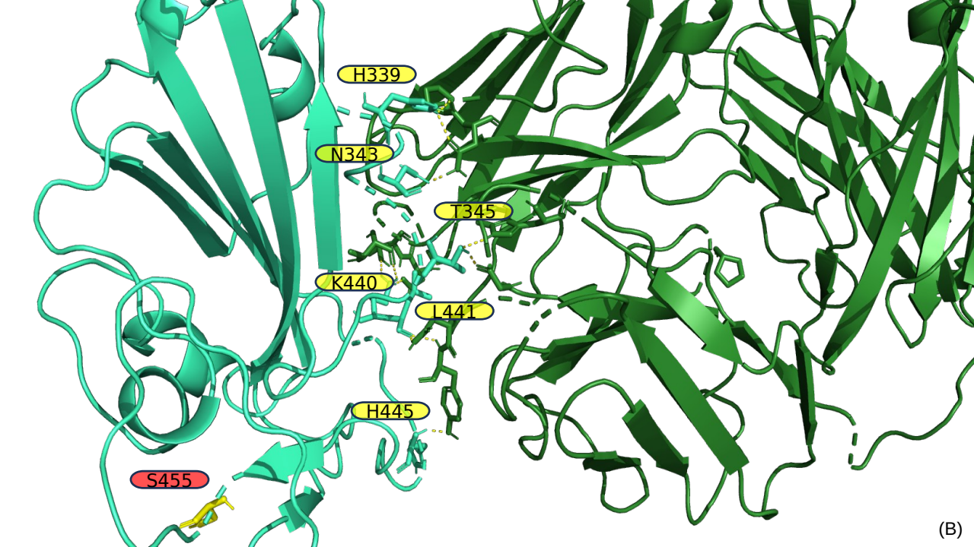
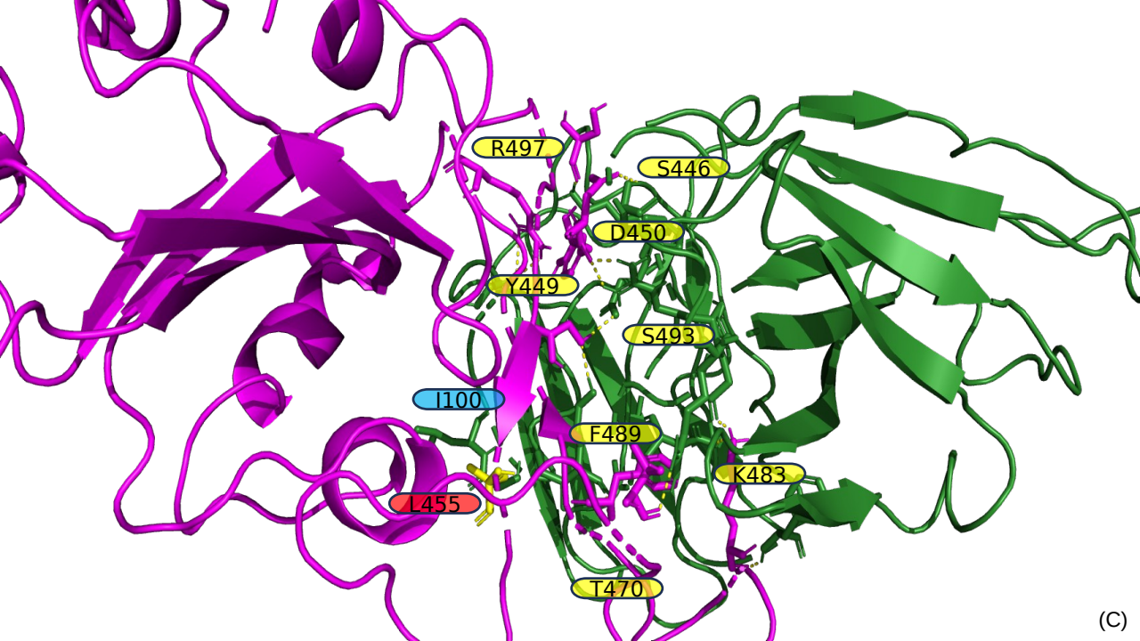
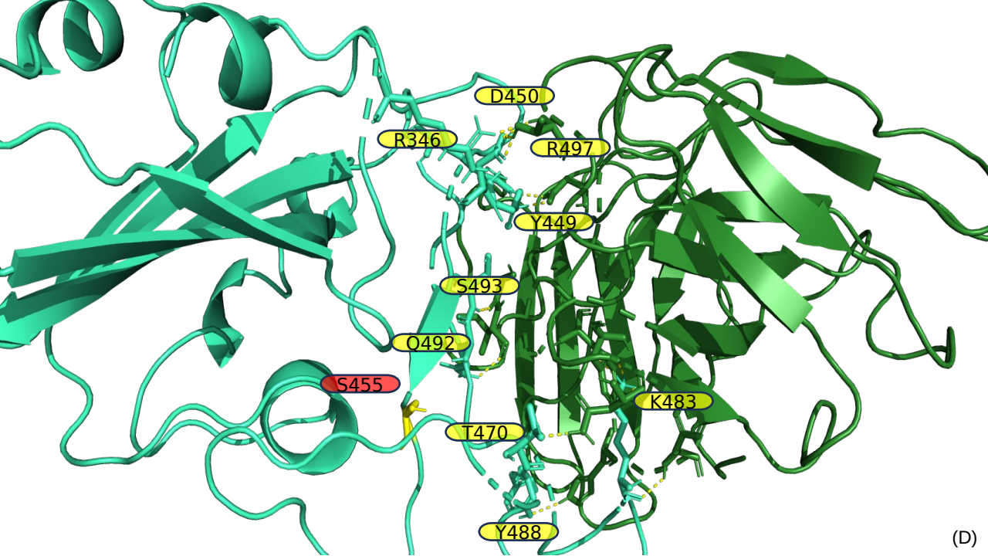

Slide 6
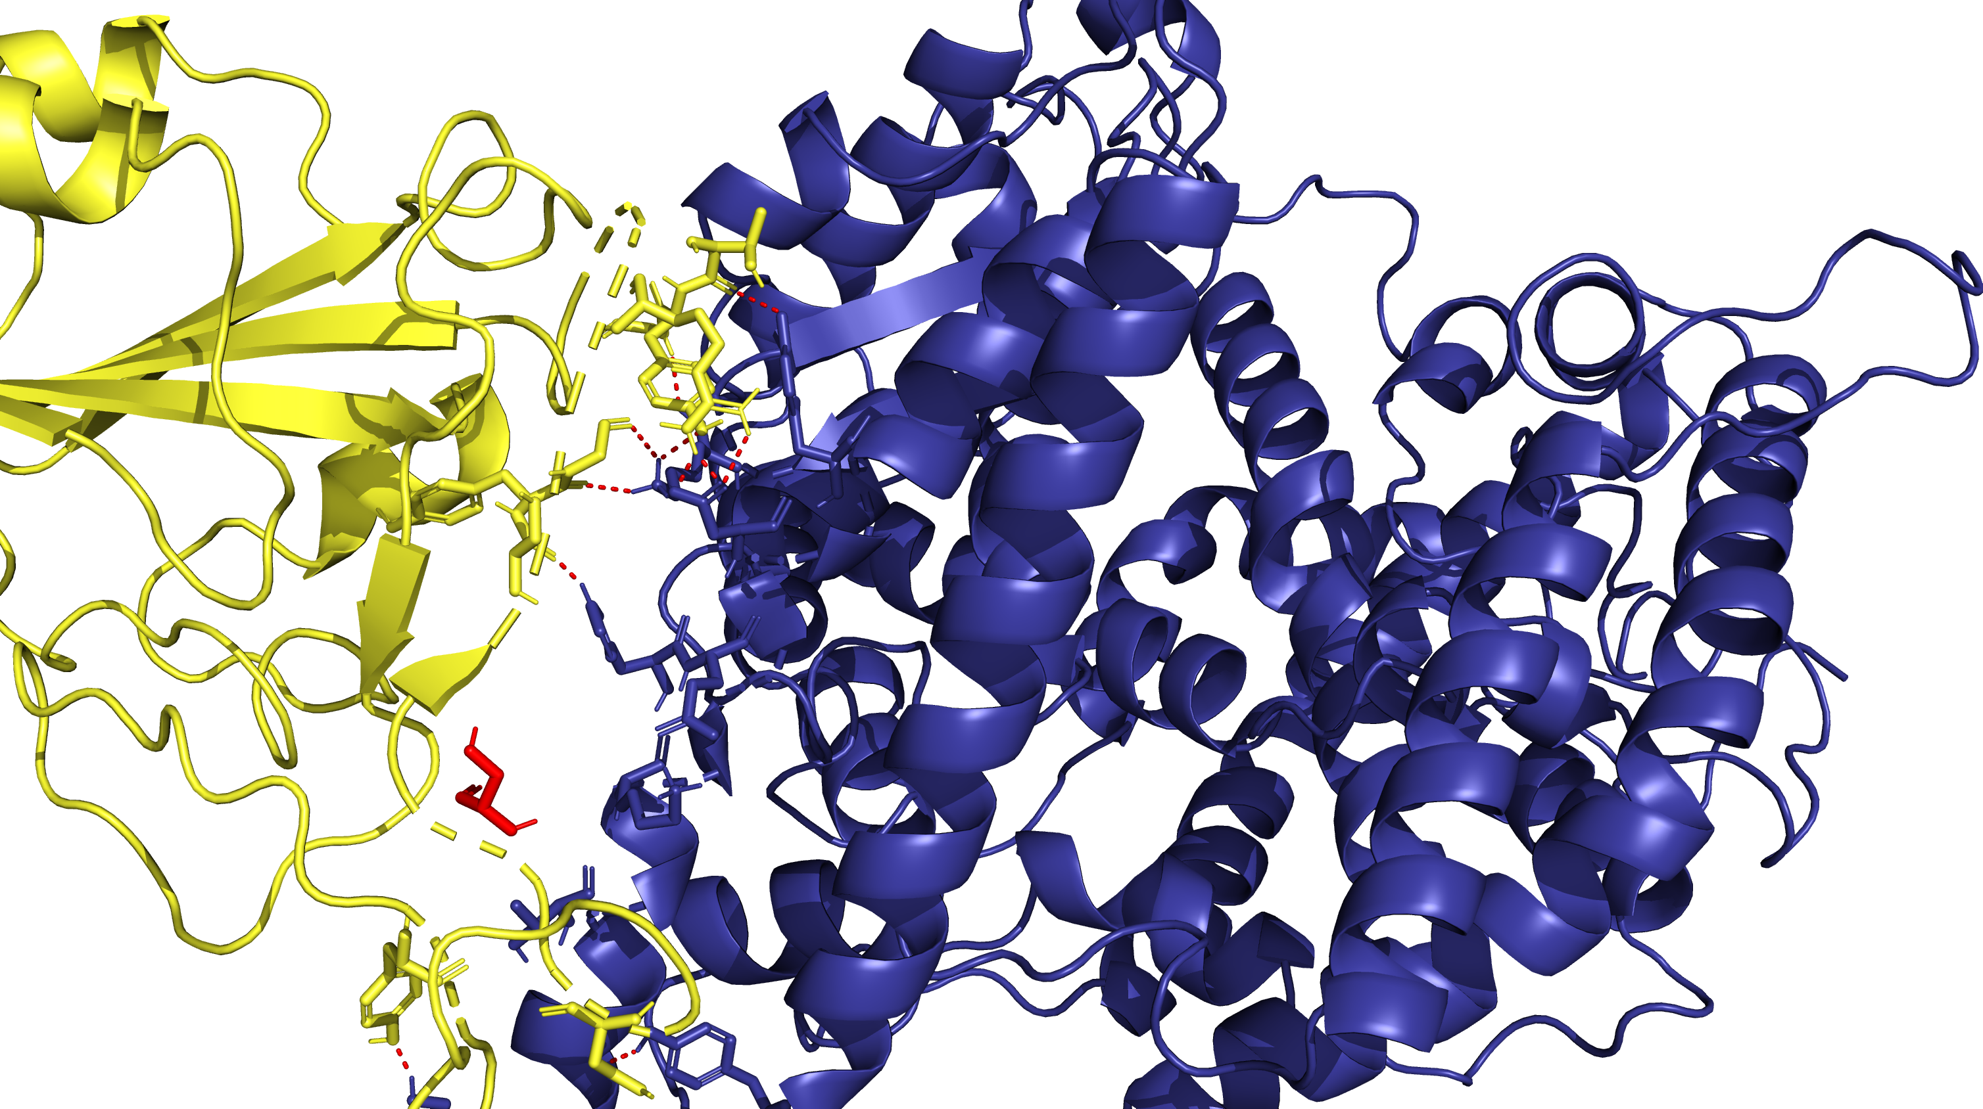
T500
G502
R498
G496
Y495
Y501
S494
H34
E35
S490
K31
T27
N487
Y473
(A)

Slide 7
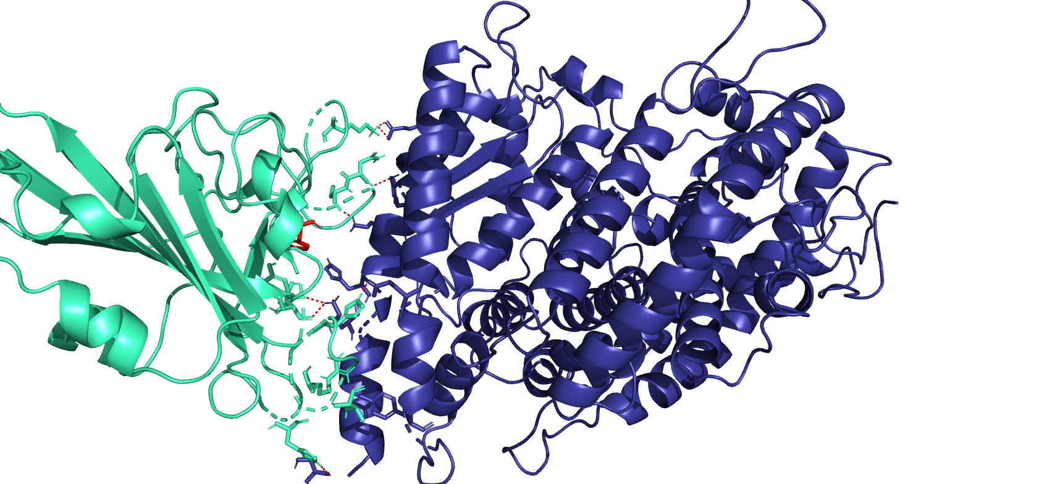
K478
N486
C487
H504
F489
H34
S493
Y494
H504
R497
T499
H445
(B)

Slide 8
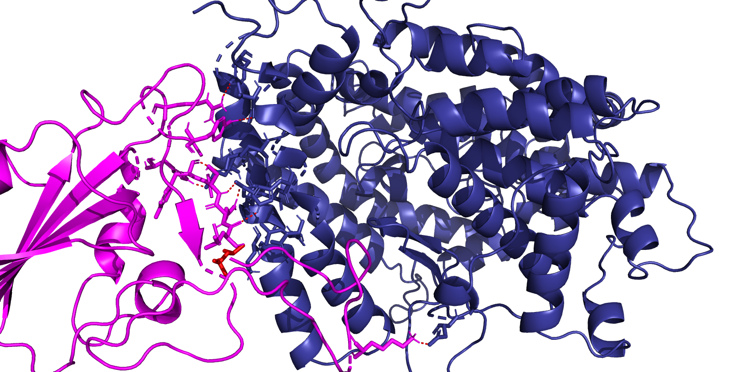
R497
Y449
H504
S493
Y494
F72
Q492
L491
L39
L455
K478
(C)

Slide 9
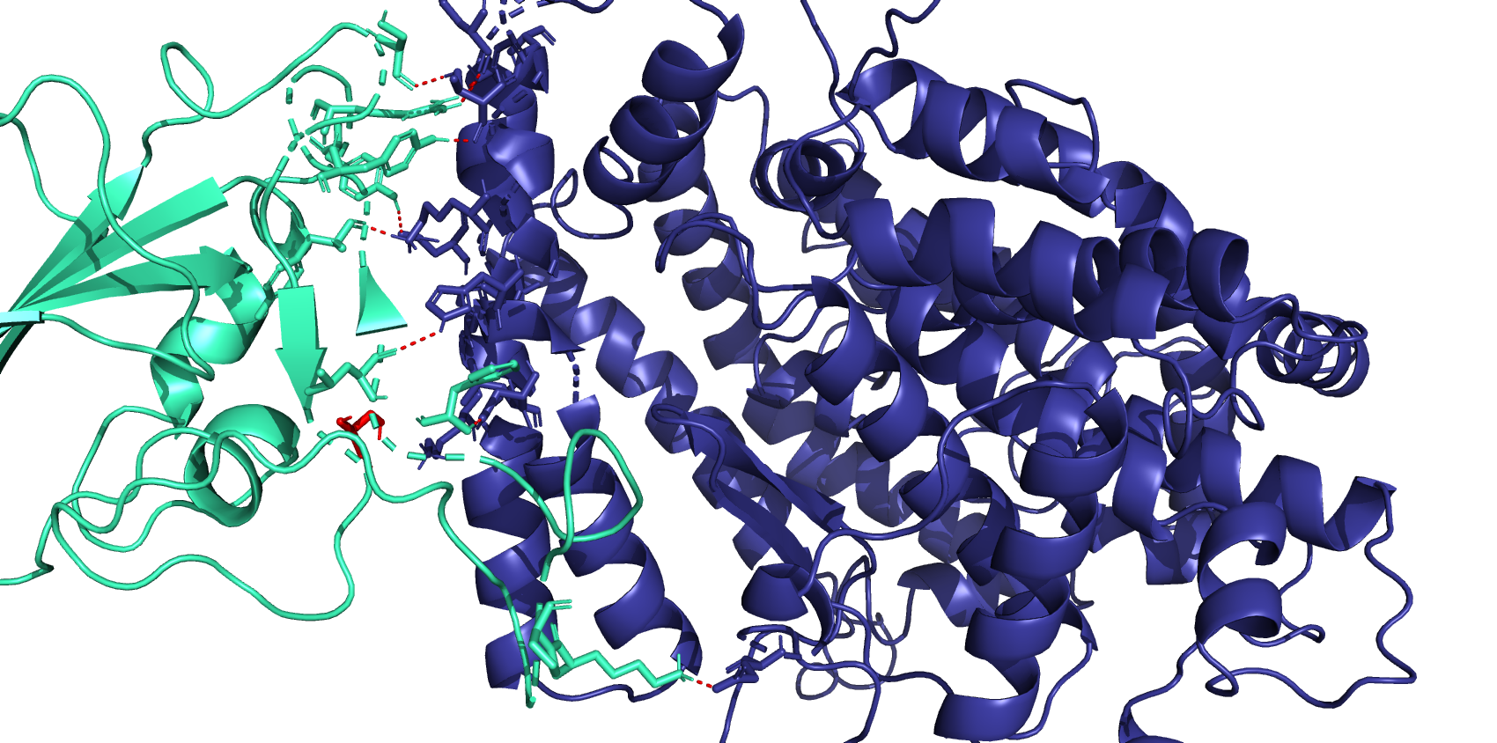
R497
S446
Y449
Y500
Y494
L491
F489
F72
S455
L39
K68
K478
(D)

Slide 10
